Slide 1
Vincent Van Gogh
1853 – 1890
Postimpressionist

Slide 2
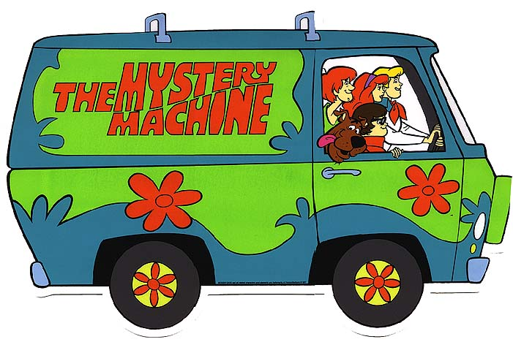
Van

Slide 3
Van Go

Slide 4
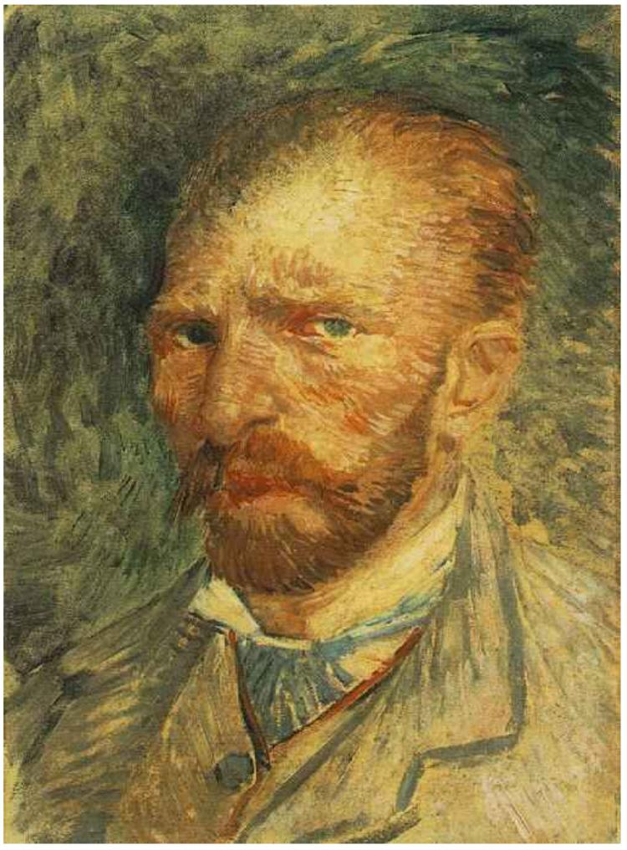
Or Van Gogh

Slide 5
Vincent Van Gogh
Postimpressionist
Born in 1853 in Holland
Died at 37 in 1890
During this time in America…
  Abraham Lincoln elected President
  Civil War
  Alexander Graham Bell invented the telephone

Slide 6
About Van Gogh
Difficult & unhappy life
Very emotional and spiritual
Wanted a family and tried to find love
Could not find a job he was good at
Sold only 1 painting his entire life
His finest works were painted within 3 years
Learned from Impressionists of the time
Ear story

Slide 7
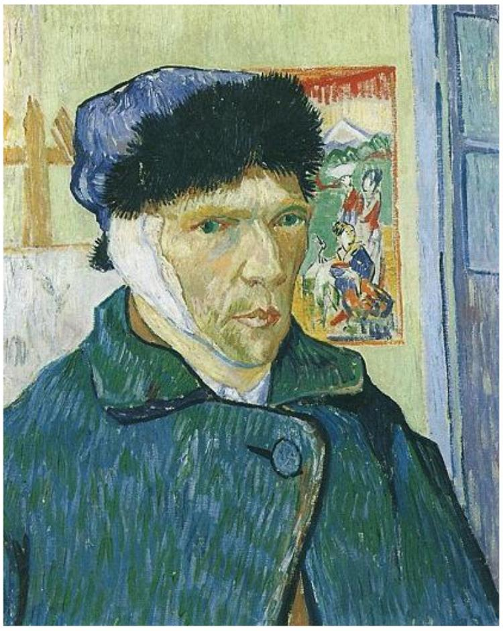
Ear Story

Slide 8
Impressionism
Short “broken” visible brush strokes
Open composition
  impression of being not finished
  extends off ends of painting
Emphasis on light
Focus on realistic images of life and nature
Monet, Renoir, Cezanne

Slide 9
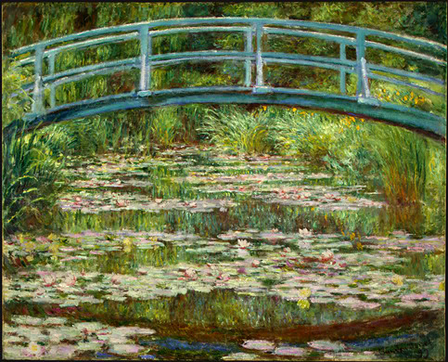
Impressionism

Slide 10
Postimpressionism
Extension of Impressionism
Emotional qualities
Personal, spiritual
Solidity
Use of strong colors

Slide 11
Techniques of Van Gogh
Powerful and Dramatic
Imaginative and emotional
Passionate brush strokes
  Symbolic and intense
  Bright colors
  Movement and vibration of line
Tried to master the art of painting people
Used reed and quill for brush strokes

Slide 12
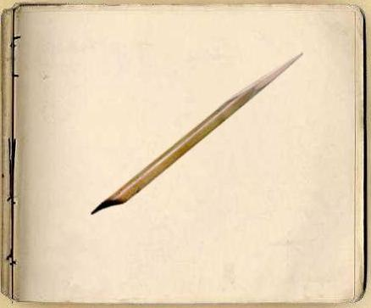
Reed

Slide 13
Works
Potato Eaters
Irises
Sunflowers
Starry Night

Slide 14
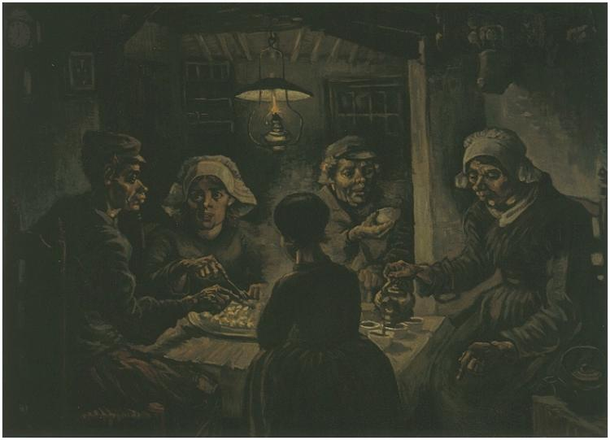
Potato Eaters

Slide 15
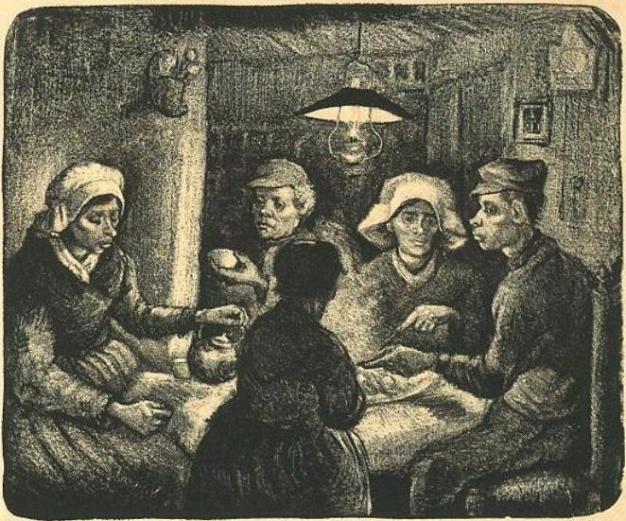
Drawing

Slide 16
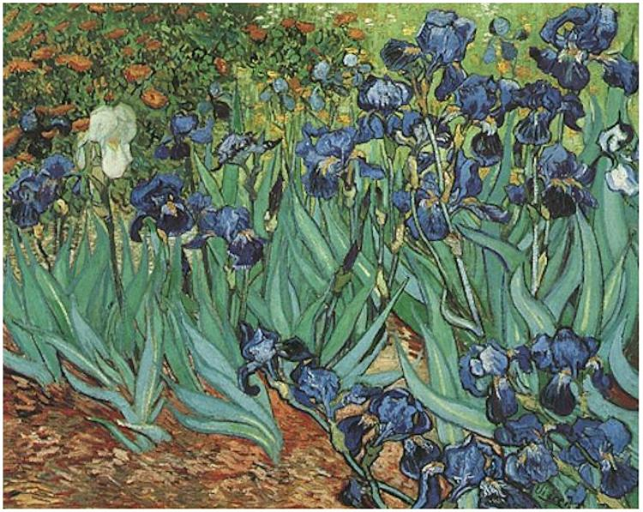
Irises

Slide 17
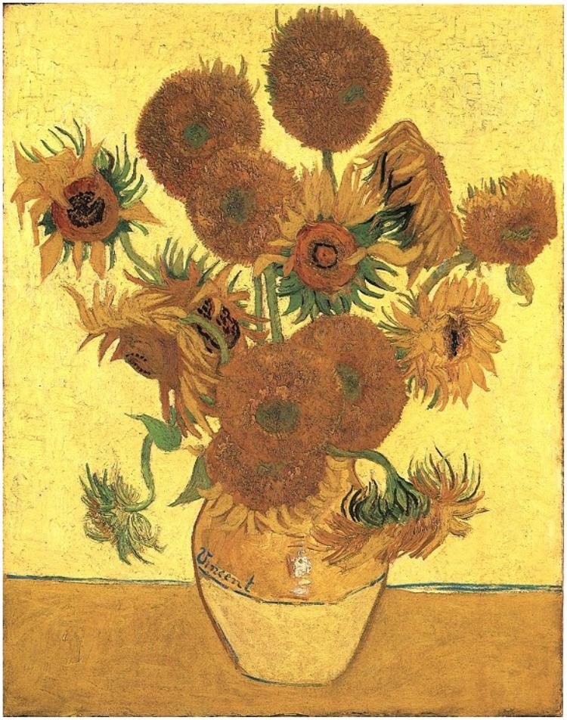
Sunflowers

Slide 18
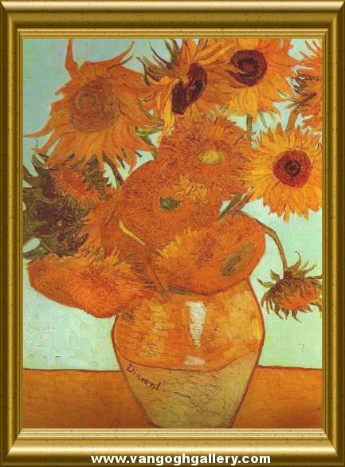
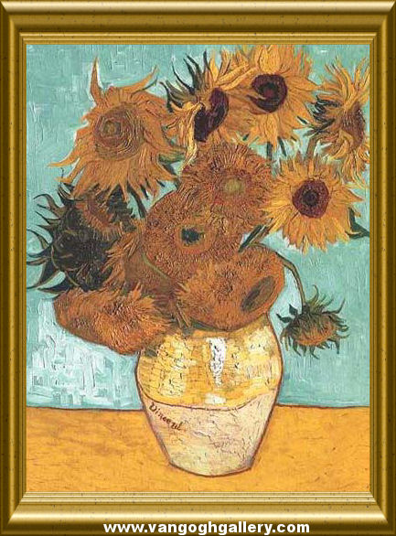
Sunflowers

Slide 19
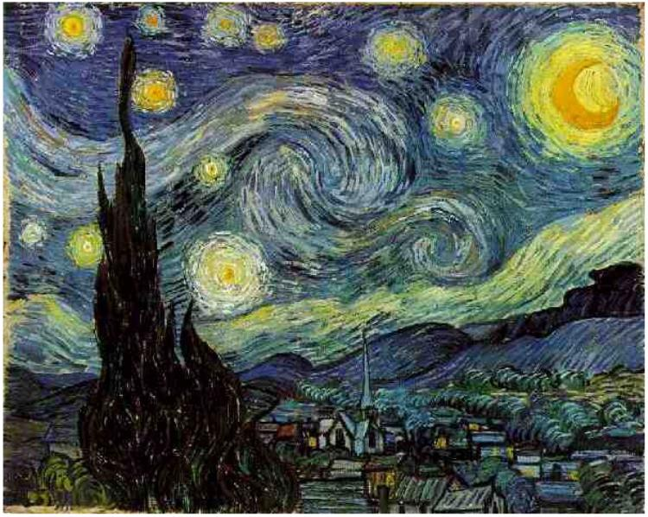
Starry Night

Slide 20
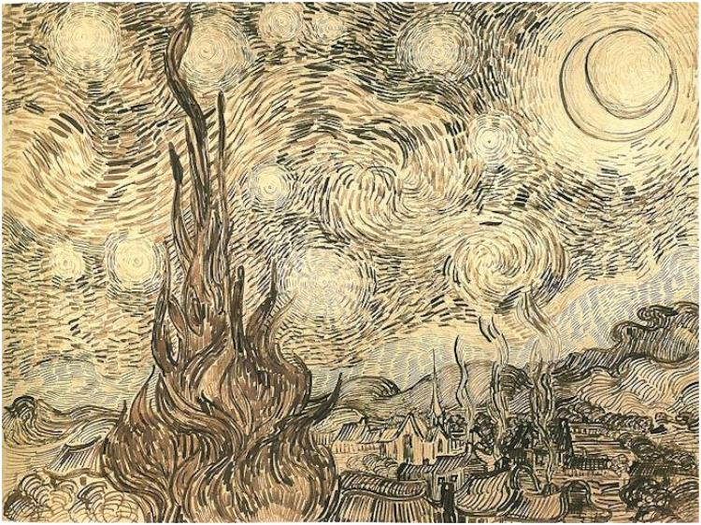
Drawing

Slide 21
Starry Night Song
http://www.youtube.com/watch?v=dipFMJckZOM

Slide 22
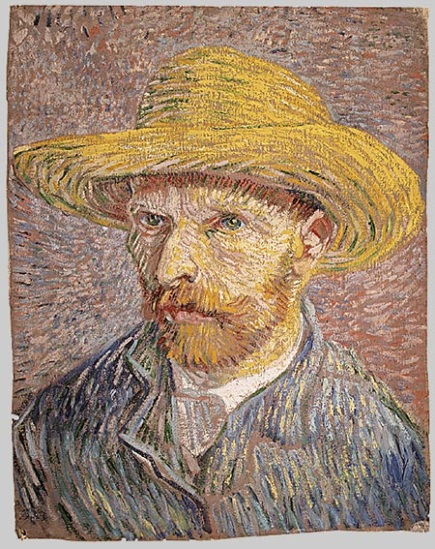
Vincent Van Gogh

Slide 23
Activities
Drawing

